Slide 1

1
HOW DO YOU USE A THANK YOU PAGE?

Slide 2
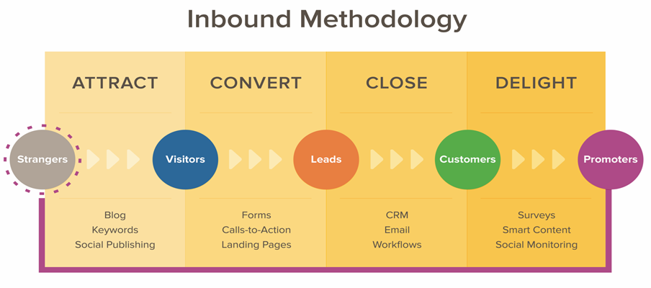

Slide 3
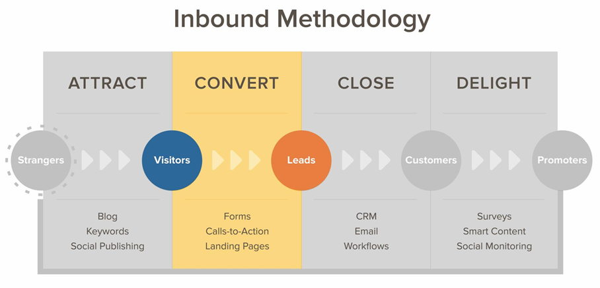

Slide 4
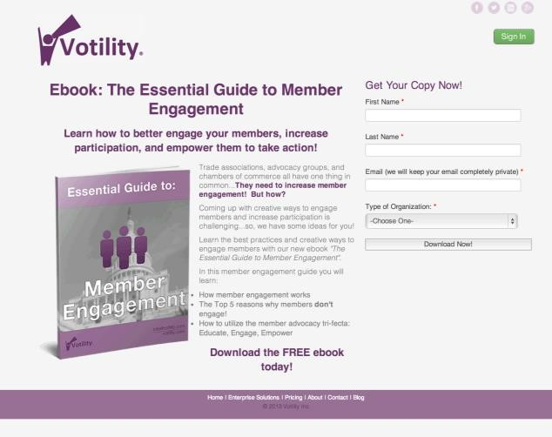
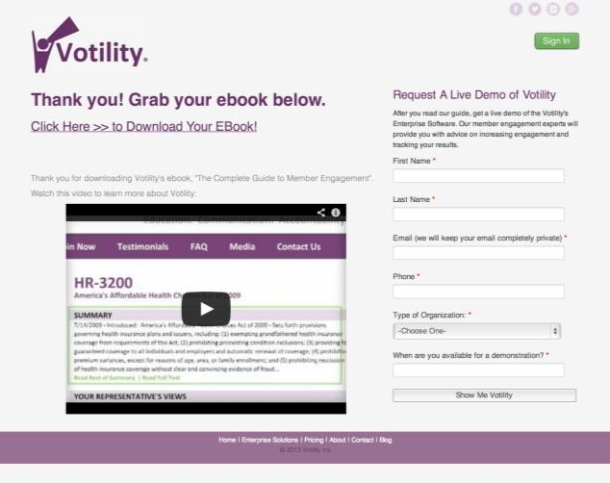
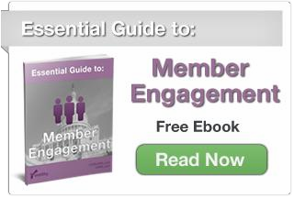

The Conversion Process
Call-to-Action
Landing Page
Thank You Page

Slide 5
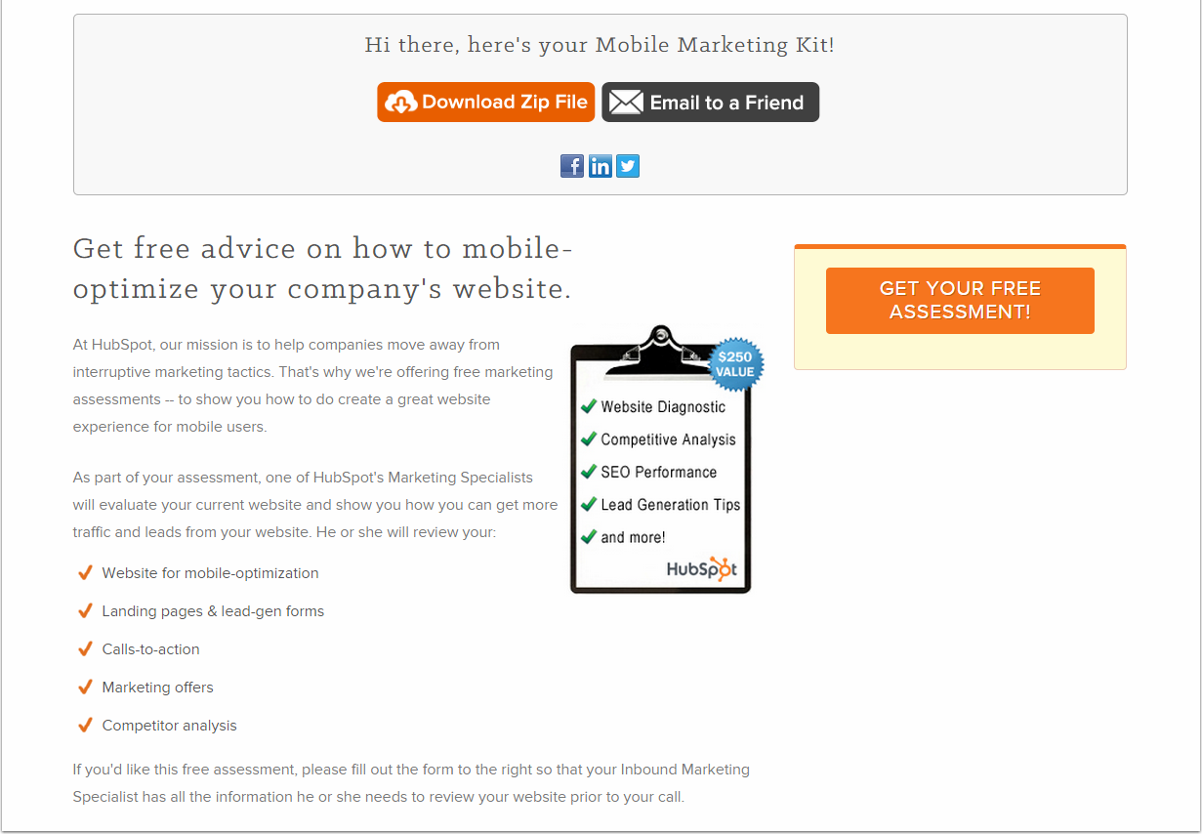
A thank you page ends the conversion process.
It can be used to help someone continue through the buyer's journey.

Slide 6
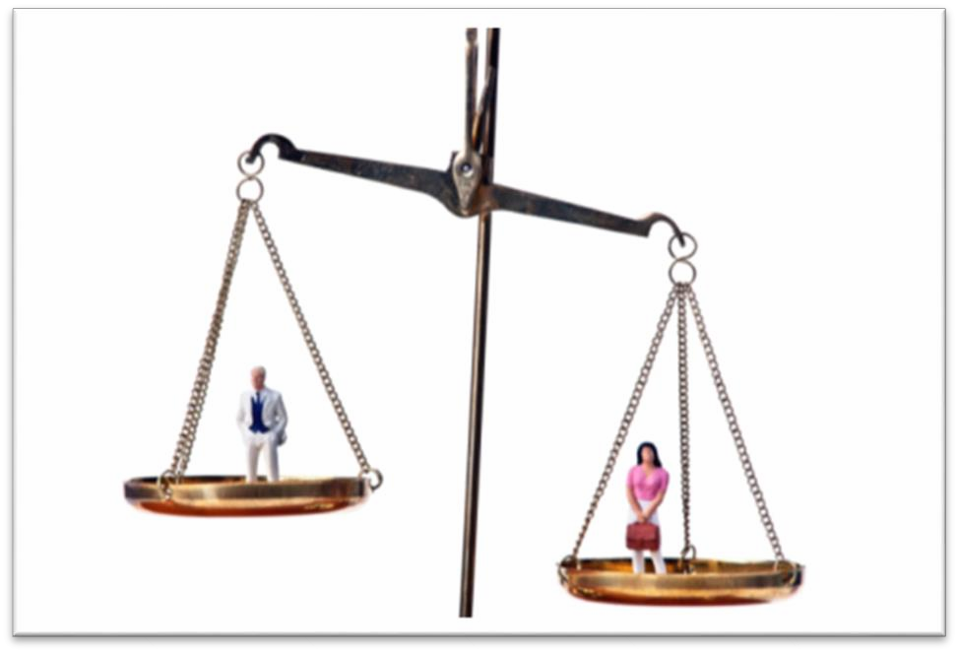
Thank you pages outweigh inline thank you messages.
Redirect your visitor to a
thank you page so that you can provide more information and thank them at the same time.

Slide 7
2
HOW DO YOU CREATE SUCCESSFUL THANK YOU PAGES?

Slide 8
WHY IS A THANK YOU PAGE MORE HELPFUL TO A MARKETER THAN AN INLINE MESSAGE?

Slide 9
WHY IS A THANK YOU PAGE MORE HELPFUL TO A MARKETER THAN AN INLINE MESSAGE?
A thank you page allows a marketer to:
Provide additional content
Move leads further into the buyer’s journey
Extend their social media reach

Slide 10

THANK YOU PAGE BEST PRACTICES
Deliver promised content offer or set expectations.
Display the site’s navigation menu.
Provide additional content.
Move new leads further into the buyer’s journey.
Include social options.

Slide 11
THANK YOU PAGE BEST PRACTICES
Deliver promised content offer or set expectations.
Display the site’s navigation menu.
Provide additional content.
Move new leads further into the buyer’s journey.
Include social options.

Slide 12
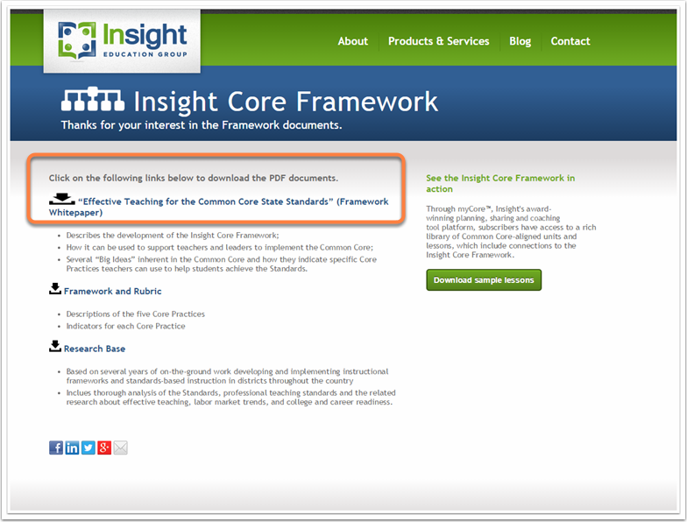
Deliver the offer that your lead is expecting.
Include a link for them to access the offer or, in some cases,
set proper expectations on what happens next.

Slide 13
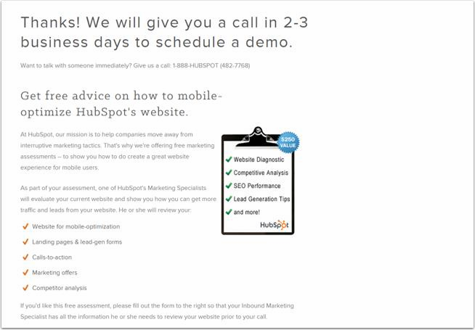
If you can’t deliver the promised offer right away, let the lead know what to expect.

Slide 14
THANK YOU PAGE BEST PRACTICES
Deliver promised content offer or set expectations.
Display the site’s navigation menu.
Provide additional content.
Move new leads further into the buyer’s journey.
Include social options.

Slide 15
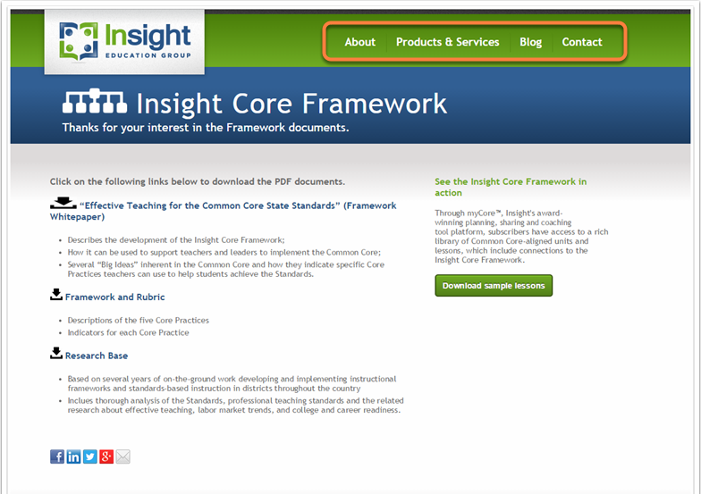
Give your leads every opportunity to look around.

Slide 16
THANK YOU PAGE BEST PRACTICES
Deliver promised content offer or set expectations.
Display the site’s navigation menu.
Provide additional content.
Move new leads further into the buyer’s journey.
Include social options.

Slide 17
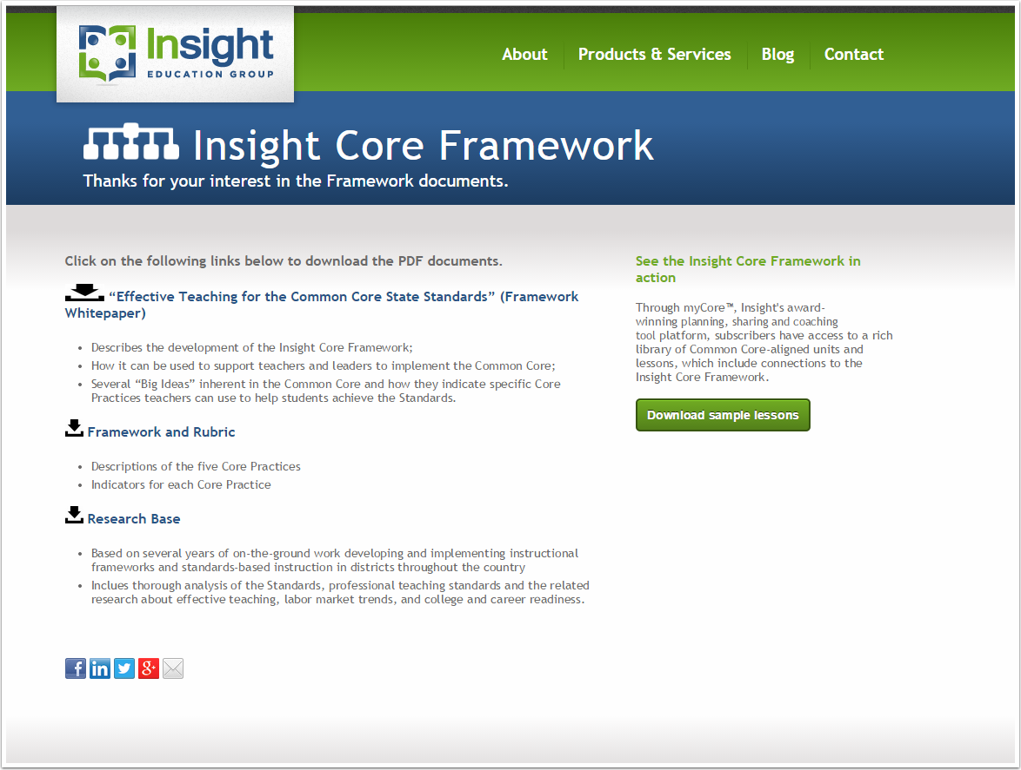

Provide
additional content.
Just make sure that these content options are closely related to the offer that the lead just received.

Slide 18
THANK YOU PAGE BEST PRACTICES
Deliver promised content offer or set expectations.
Display the site’s navigation menu.
Provide additional content.
Move new leads further into the buyer’s journey.
Include social options.

Slide 19

Move leads further into the buyer’s journey.
Use this opportunity to show another offer that might be of interest to them.

Slide 20
THANK YOU PAGE BEST PRACTICES
Deliver promised content offer or set expectations.
Display the site’s navigation menu.
Provide additional content.
Move new leads further into the buyer’s journey.
Include social options.

Slide 21

Use social options.
The thank you page can be a great place to extend your reach on social networks and generate more leads.

Slide 22
THANK YOU PAGE BEST PRACTICES
Deliver promised content offer or set expectations.
Display the site’s navigation menu.
Provide additional content.
Move new leads further into the buyer’s journey.
Include social options.

Slide 23
3
WHAT DOES AN EFFECTIVE THANK YOU PAGE LOOK LIKE?

Slide 24
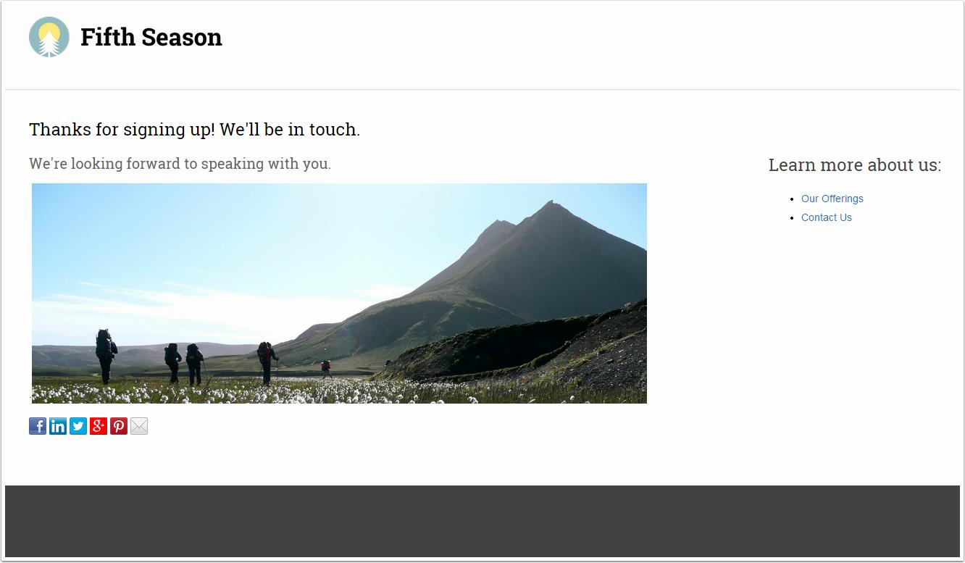

Slide 25
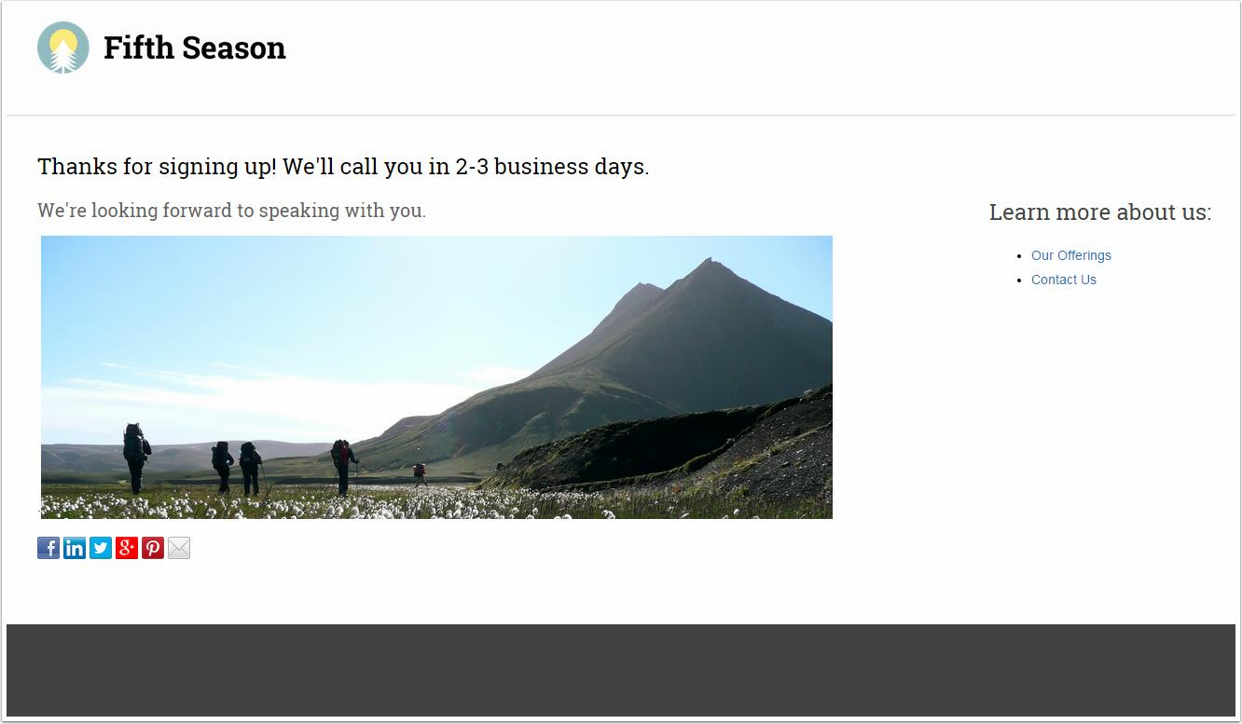

Slide 26


Slide 27
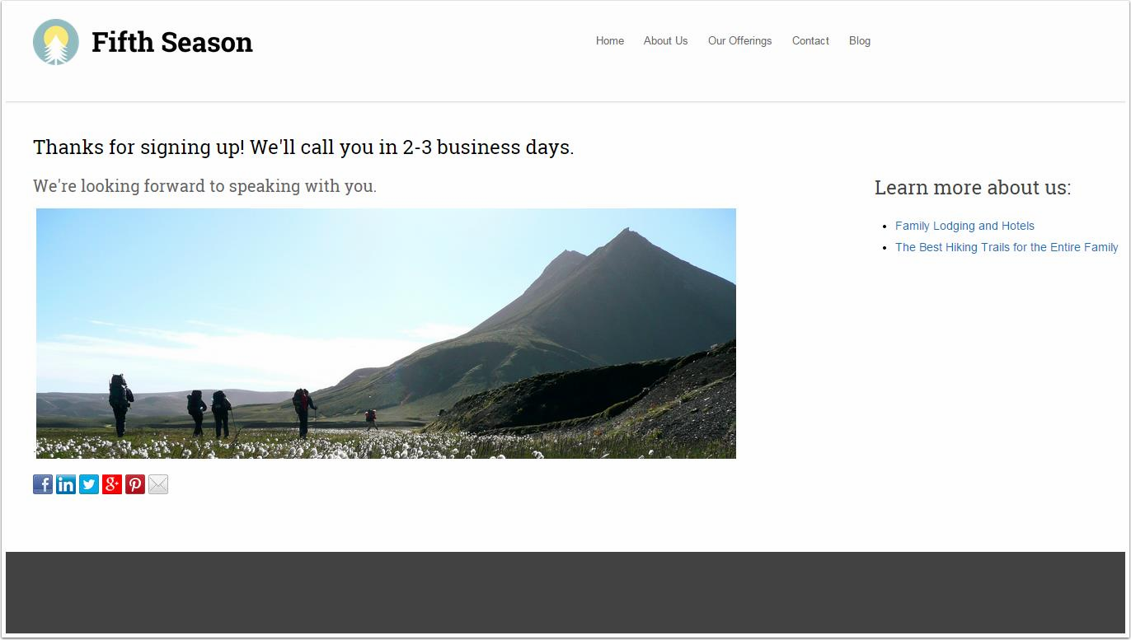

Slide 28
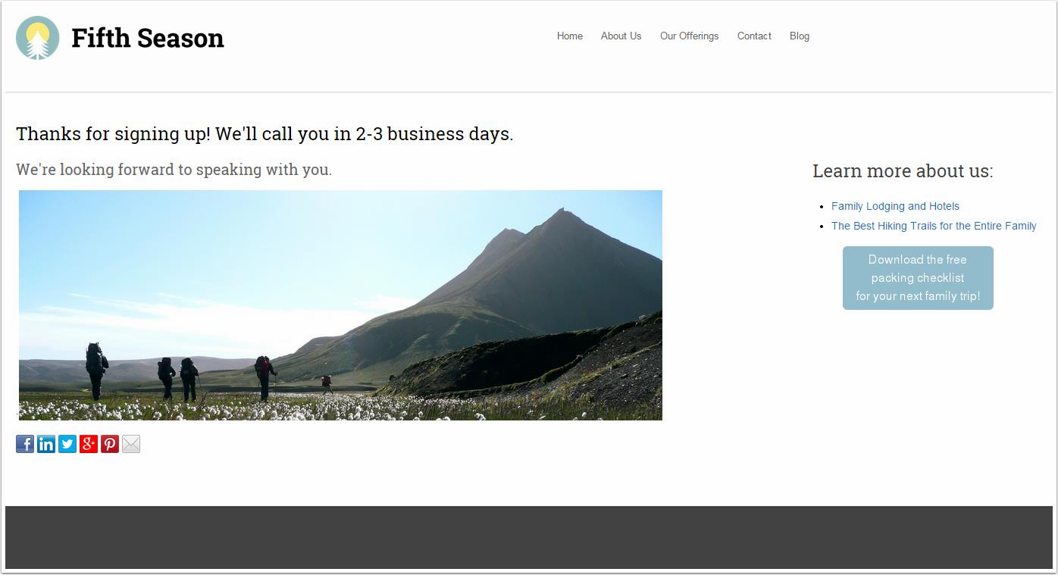

Slide 29
THANK YOU.

